Slide 1
Introduction to NLP Vector Space Model
Dr. Paul Buitelaar
Data Science Institute, University of Galway

Slide 2
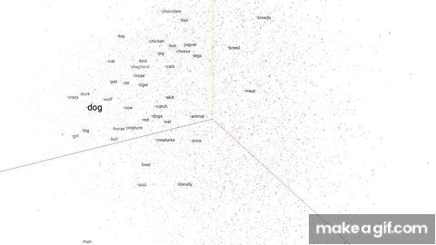
https://i.makeagif.com/media/6-07-2022/0QaCig.gif

Slide 3
Learning Objectives
Understand the distributional (vector space) model for NLP
Learn how to construct and use word vectors in semantic similarity
Insight into use of linguistic context in constructing word vectors
Introduction to word embeddings

Slide 4
Vector Space Model
Foundations in Information Retrieval (Salton et al., 1975)
Represent document set by distribution of index terms
Represent distributional model in vector space
Salton, G., Wong, A., & Yang, C. S. (1975). A vector space model for automatic indexing. Communications of the ACM, 18(11), 613-620.

Slide 5
Document Set
Government publishes NPHET advice
Doc1
NPHET concerned about outbreaks in workplaces
Doc2
NPHET advice says it is impossible to predict the trajectory of Covid-19
Doc3

Slide 6
Index Terms
Government publishes NPHET advice
Doc1
Content words (nouns, verbs, adjectives), ignoring stopwords (about, in, it, is, ...)
NPHET concerned about outbreaks in workplaces
Doc2
NPHET advice says it is impossible to predict the trajectory of Covid-19
Doc3

Slide 7
Inverted Index
Index Term | Document ID
advice | 1,3
concerned | 2
Covid-19 | 3
Government | 1
impossible | 3
NPHET | 1,2,3
outbreaks | 2
predict | 3
publishes | 1
says | 3
trajectory | 3
workplaces | 2
Term-Document matrix (alphabetically sorted)

Slide 8
Document Vectors
Index Term | Term ID | Document ID
advice | T1 | 1,3
concerned | T2 | 2
Covid-19 | T3 | 3
Government | T4 | 1
impossible | T5 | 3
NPHET | T6 | 1,2,3
outbreaks | T7 | 2
predict | T8 | 3
publishes | T9 | 1
says | T10 | 3
trajectory | T11 | 3
workplaces | T12 | 2
T1,T2,T3,T4,…,T11, T12
Doc1 [1,0,0,1,0,1,0,0,1,0,0,0]
Doc2 [0,1,0,0,0,1,1,0,0,0,0,1]
Doc3 [1,0,1,0,1,1,0,1,0,1,1,0]

Slide 9
Document Retrieval
Index Term | Term ID | Document ID
advice | T1 | 1,3
concerned | T2 | 2
Covid-19 | T3 | 3
Government | T4 | 1
impossible | T5 | 3
NPHET | T6 | 1,2,3
outbreaks | T7 | 2
predict | T8 | 3
publishes | T9 | 1
says | T10 | 3
trajectory | T11 | 3
workplaces | T12 | 2
Doc1 [1,0,0,1,0,1,0,0,1,0,0,0]
Doc2 [0,1,0,0,0,1,1,0,0,0,0,1]
Doc3 [1,0,1,0,1,1,0,1,0,1,1,0]
What is the NPHET Government advice?

Slide 10
Document Retrieval
Index Term | Term ID | Document ID
advice | T1 | 1,3
concerned | T2 | 2
Covid-19 | T3 | 3
Government | T4 | 1
impossible | T5 | 3
NPHET | T6 | 1,2,3
outbreaks | T7 | 2
predict | T8 | 3
publishes | T9 | 1
says | T10 | 3
trajectory | T11 | 3
workplaces | T12 | 2
Doc1 [1,0,0,1,0,1,0,0,1,0,0,0]
Doc2 [0,1,0,0,0,1,1,0,0,0,0,1]
Doc3 [1,0,1,0,1,1,0,1,0,1,1,0]
What is the NPHET Government advice?
Query [1,0,0,1,0,1,0,0,0,0,0,0]

Slide 11
Vector Space
What is the NPHET Government advice?
Query [1,0,0,1,0,1,0,0,0,0,0,0]
Government publishes NPHET advice
Doc1 [1,0,0,1,0,1,0,0,1,0,0,0]
Doc1
Query
Doc2
Doc3

Slide 12
Buzz Groups
What else can we represent?

Slide 13
Term Vectors
Index Term | Term ID | Document ID
advice | T1 | 1,3
concerned | T2 | 2
Covid-19 | T3 | 3
Government | T4 | 1
impossible | T5 | 3
NPHET | T6 | 1,2,3
outbreaks | T7 | 2
predict | T8 | 3
publishes | T9 | 1
says | T10 | 3
trajectory | T11 | 3
workplaces | T12 | 2
Doc1,Doc2, Doc3
T1 [1,0,1]
T2 [0,1,0]
T3 [0,0,1]
….
T10 [0,0,1]
T11 [0,0,1]
T12 [0,1,0]

Slide 14
Vector Space
T1 [1,0,1]
T2 [0,1,0]
T3 [0,0,1]
….
T10 [0,0,1]
T11 [0,0,1]
T12 [0,1,0]
T1
T2,T12
T3,T10,T11

Slide 15
Latent Semantics
Represent index terms by their distribution over documents
Index terms with similar meaning will show similarity in distributions
‘Latent Semantic Analysis’ (LSA) or ‘Latent Semantic Indexing’ (LSI)
(Deerwester et al., 1990)
Deerwester, S., Dumais, S.T., Furnas, G.W., Landauer, T.K. and Harshman, R., 1990. Indexing by latent semantic analysis. Journal of the American society for information science, 41(6), pp.391-407.

Slide 16
Overview
Vector Space Model
Distributional Semantics
Context in Distributional Representations
Word Embeddings

Slide 17
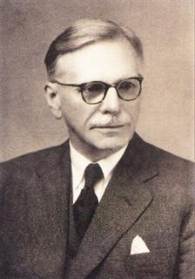
Distributional Hypothesis
“you shall know a word by the company it keeps” - (Firth 1957)
cat and dog occur in similar contexts, therefore similar in meaning
Distributional Semantics
Firth, J.R. (1957). "A synopsis of linguistic theory 1930-1955". Studies in Linguistic Analysis: 1–32

Slide 18
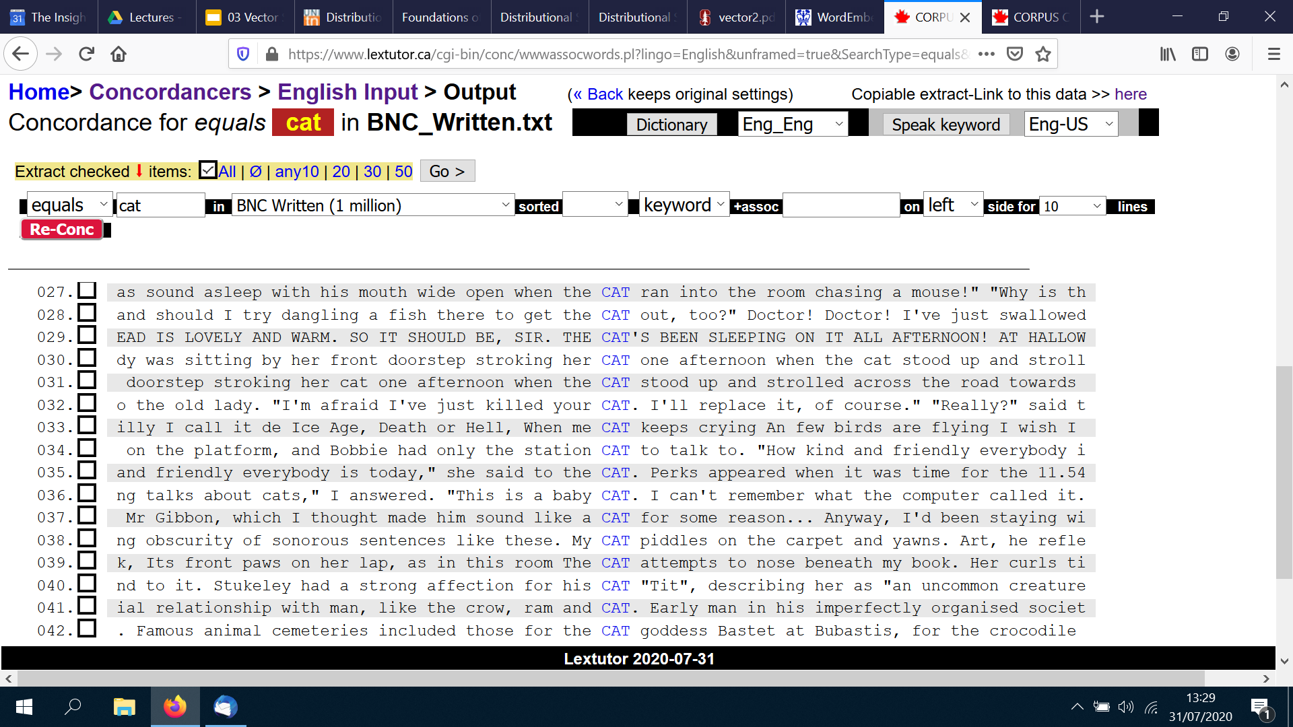
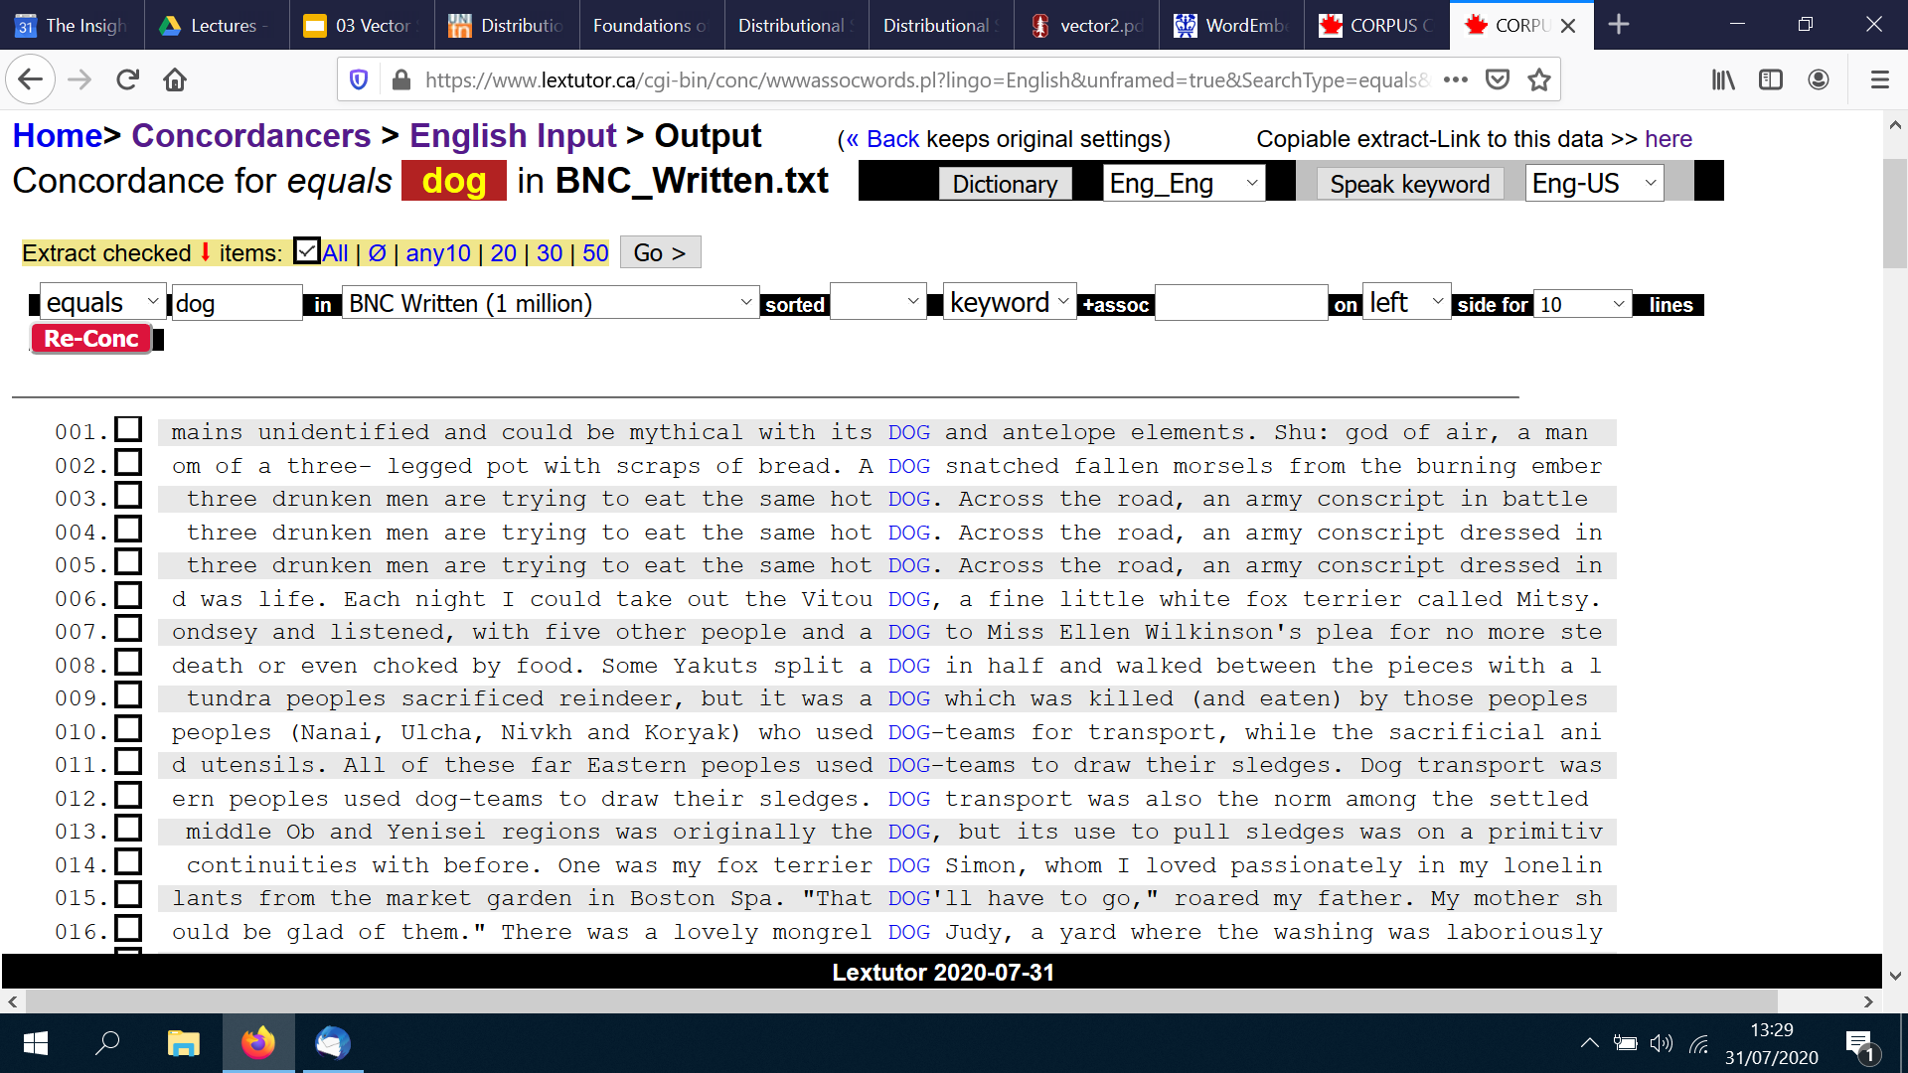
Distributional Semantics - Context Words
Concordance examples generated with https://www.lextutor.ca/conc/

Slide 19
Target and Context Words in a Corpus
Corpus
The cat lies on the mat.
The dog lies on the floor.
The cat sits near the door.
The dog lies near the door
Targets
cat, dog
Vocabulary of context words (V)
the, lies, on, mat, floor, sits, near, door

Slide 20
Co-occurrence Matrix (Context N=1)
Corpus
The cat lies on the mat.
The dog lies on the floor.
The cat sits near the door.
The dog lies near the door
Targets
cat, dog
Vocabulary of context words (V)
the, lies, on, mat, floor, sits, near, door
V | the | lies | on | mat | floor | sits | near | door
cat | 1 | 1
dog

Slide 21
Co-occurrence Matrix (Context N=1)
Corpus
The cat lies on the mat.
The dog lies on the floor.
The cat sits near the door.
The dog lies near the door
Targets
cat, dog
Vocabulary of context words (V)
the, lies, on, mat, floor, sits, near, door
V | the | lies | on | mat | floor | sits | near | door
cat | 2 | 1 |  |  |  | 1
dog

Slide 22
Co-occurrence Matrix (Context N=1)
Corpus
The cat lies on the mat.
The dog lies on the floor.
The cat sits near the door.
The dog lies near the door
Targets
cat, dog
Vocabulary of context words (V)
the, lies, on, mat, floor, sits, near, door
V | the | lies | on | mat | floor | sits | near | door
cat | 2 | 1 |  |  |  | 1
dog | 1 | 1

Slide 23
Co-occurrence Matrix (Context N=1)
Corpus
The cat lies on the mat.
The dog lies on the floor.
The cat sits near the door.
The dog lies near the door
Targets
cat, dog
Vocabulary of context words (V)
the, lies, on, mat, floor, sits, near, door
V | the | lies | on | mat | floor | sits | near | door
cat | 2 | 1 |  |  |  | 1
dog | 2 | 2

Slide 24
Co-occurrence Matrix (Context N=1)
Corpus
The cat lies on the mat.
The dog lies on the floor.
The cat sits near the door.
The dog lies near the door
Targets
cat, dog
Vocabulary of context words (V)
the, lies, on, mat, floor, sits, near, door
V | the | lies | on | mat | floor | sits | near | door
cat | 2 | 1 | 0 | 0 | 0 | 1 | 0 | 0
dog | 2 | 2 | 0 | 0 | 0 | 0 | 0 | 0

Slide 25
Word Vectors for cat, dog
V | the | lies | on | mat | floor | sits | near | door
cat | 2 | 1 | 0 | 0 | 0 | 1 | 0 | 0
dog | 2 | 2 | 0 | 0 | 0 | 0 | 0 | 0

Slide 26
3 Non-Zero Dimensions
V | the | lies | on | mat | floor | sits | near | door
cat | 2 | 1 | 0 | 0 | 0 | 1 | 0 | 0
dog | 2 | 2 | 0 | 0 | 0 | 0 | 0 | 0
Notice many zeros (sparse vector)

Slide 27
Vector Space for cat, dog with 3 Dimensions
sits
V | the | lies | on | mat | floor | sits | near | door
cat | 2 | 1 | 0 | 0 | 0 | 1 | 0 | 0
dog | 2 | 2 | 0 | 0 | 0 | 0 | 0 | 0
cat
the
lies
dog

Slide 28
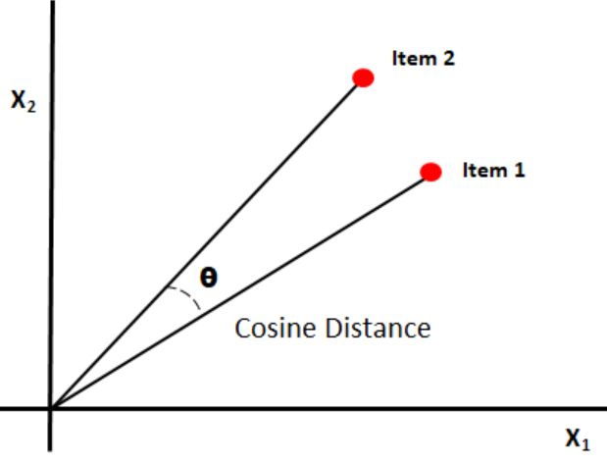
Distributional Similarity
Compute similarity of two words using their vector representations
Compute cosine of angle between two vectors
Cosine similarity (or ‘cosine distance’)
Image from https://www.oreilly.com/library/view/statistics-for-machine

Slide 29
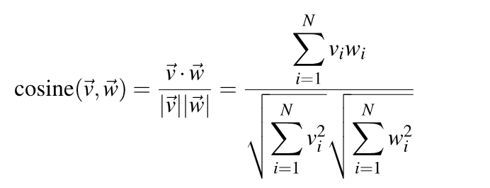
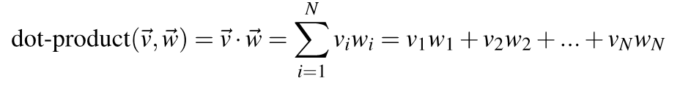
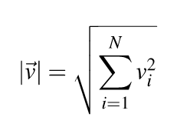
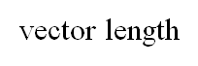
Cosine Similarity
v_{i} w_{i} is the count for word v,w in context i

Slide 30
Cosine Similarity - Example
cat | 5 | 1 | 1 | 1 | 0
dog | 3 | 1 | 1 | 0 | 1
child | 3 | 1 | 1 | 0 | 1
cos (cat, dog) = 15+1+1+0+0 / (√ 25+1+1+1+0 * √ 9+1+1+0+1)
= 17 / (√ 28 * √ 12 )
= 17 / (5.29 * 3.46)
= 0.93
cos (cat, child) = 15+1+1+0+0 / (√ 25+1+1+1+0 * √ 9+1+1+0+1)
= 17 / (√ 28 * √ 12)
= 17 / (5.29 * 3.46)
= 0.93
cos (dog, child) = 9+1+1+0+1 / (√ 9+1+1+0+1 * √ 9+1+1+0+1)
= 12 / (√ 12 * √ 12)
= 12 / (3.46 * 3.46)
= 1.00

Slide 31
Buzz Groups
What does it actually mean when two words are ‘similar’?

Slide 32
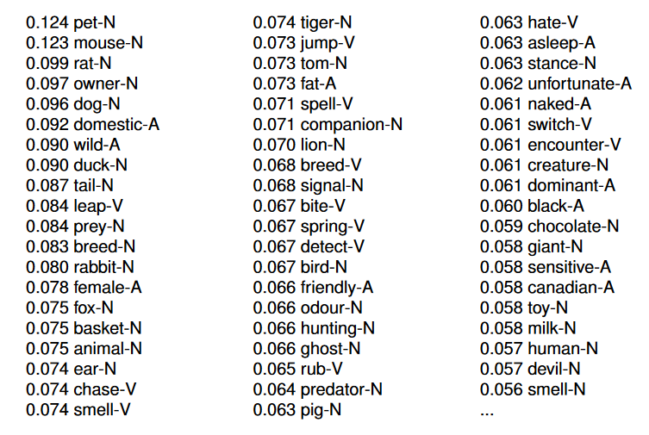
Word Similarity & Relatedness
Similarity of cat to other words in the British National Corpus
Notice ‘relatedness’ instead of ‘similarity’ in many cases
Example from http://disi.unitn.it/~bernardi/Courses/CL/Slides/ds_semantics.pdf

Slide 33
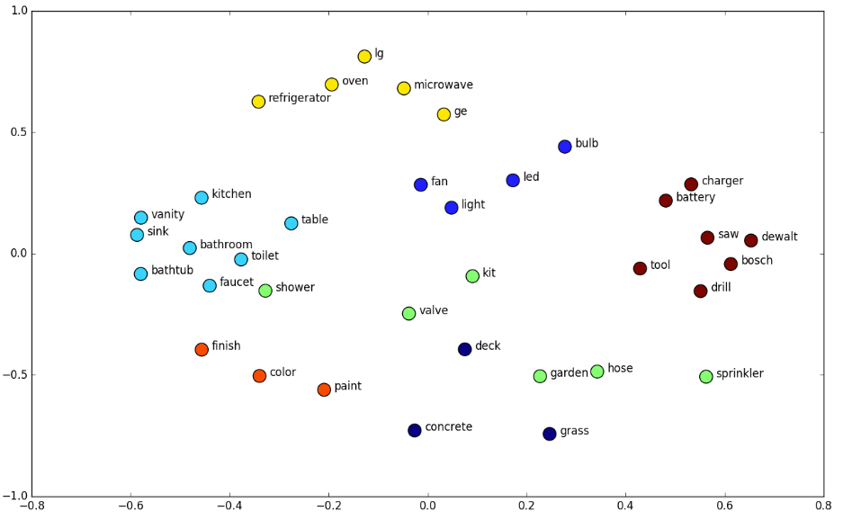
Visualizing Word Similarity
Principal Component Analysis (PCA) to project into 2D space
https://en.wikipedia.org/wiki/Principal_component_analysis
Image source: University of Virginia

Slide 34
Overview
Vector Space Model
Distributional Semantics
Context in Distributional Representations
Word Embeddings

Slide 35
Context
Context window
document, sentence, phrase, word sequence
Context content
stopwords, specific part-of-speech, syntactic dependencies, etc.
Context weights
measure of co-occurrence strength between target and context words

Slide 36
Context Window - Document
As carnivores, cats eat herbivores like mice and voles. Since these herbivores eat grass, the free-roaming cat ingests any grass inside its prey's stomach and intestines. Grass provides the cat with roughage, which helps move hair ingested during grooming along the gastrointestinal tract.
A pet cat has been diagnosed with Covid-19, the first case of animal infection with coronavirus in the UK, the government has confirmed. The animal, which is said to have only experienced mild symptoms, is not believed to been involved in transmitting the disease to its owners or other humans and animals.

Slide 37
Context Window - Sentence
As carnivores, cats eat herbivores like mice and voles.
Since these herbivores eat grass, the free-roaming cat ingests any grass inside its prey's stomach and intestines.
Grass provides the cat with roughage, which helps move hair ingested during grooming along the gastrointestinal tract.
A pet cat has been diagnosed with Covid-19, the first case of animal infection with coronavirus in the UK, the government has confirmed.

Slide 38
Context Window - Word Sequence (N=2)
as carnivores, cats eat herbivores
the free-roaming cat ingests any
provides the cat with roughage
a pet cat has been

Slide 39
Context Content - Remove Stopwords
as carnivores, cats eat herbivores
the free-roaming cat ingests any
provides the cat with roughage
a pet cat has been

Slide 40
Context Content - PoS Tagging
as carnivores-N, cats eat-V herbivores-N
the free-roaming-Adj cat ingests-V any
provides-V the cat with roughage-N
a pet-Adj cat has been

Slide 41
Context Content - Syntactic Dependencies
as carnivores-N-NMOD, cats eat-V herbivores-N-DOBJ
the free-roaming-Adj-AMOD cat ingests-V any
provides-V the cat with roughage-N-POBJ
a pet-Adj-AMOD cat has been

Slide 42
Buzz Groups
What could be the effect of dependency analysis on word similarity?

Slide 43
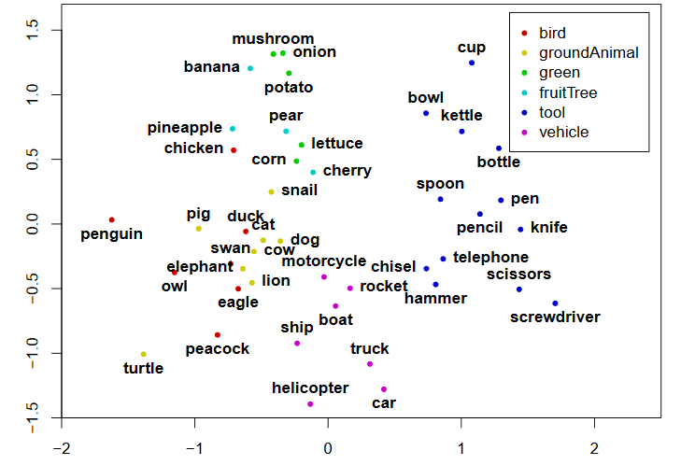
Syntactic Dependencies - Example
Similarity of nouns in syntactic dependency relation DOBJ with verbs in the BNC corpus
For example:
eat-V mushrooms-N-DOBJ
eat-V onions-N-DOBJ
eat-V potatoes-N-DOBJ
use-V spoon-N-DOBJ
use-V pen-N-DOBJ
...
Example from slides by Stefan Evert https://esslli2016.unibz.it/wp-content/uploads/2015/10/dsm_tutorial_part1.slides.pdf

Slide 44
Context - Occurrence, Frequency, Weight
Binary
the value of vector for dimension c is 1 if context c occurs with word w and 0 otherwise
Frequency
the value of vector for dimension c is the number of times that context c occurs with word w
Weight (Relevance, Specificity)
the value of vector for dimension c is a weight, expressing how relevant or specific context c is for word w

Slide 45
Examples
As carnivores, a cat eats mice and voles but eats no grass.
Binary - 1 or 0 depending if the context word occurs in this sentence
{eats:1, mice:1, voles:1, sits:0}
Frequency - count of the context word in this sentence
{eats:2, mice:1, voles:1, sits:0}
Weight - weight of the context word in a corpus of sentences
{eats:0.95, mice:0.56, voles:0.01, sits:0.80}

Slide 46
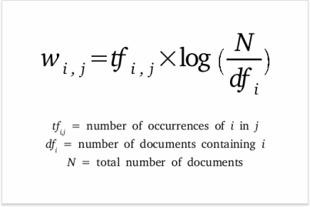
Context Weight - TF-IDF
Image source: https://www.searchenginejournal.com/tf-idf-can-it-really-help-your-seo/331075/

Slide 47
Context Weight - PMI
Pointwise Mutual Information (PMI)
PMI is a correlation or association measure that quantifies the likelihood of co-occurrence of two events.
In distributional semantics we use PMI to measure the likelihood of co-occurrence of two words w₁ , w₂ across a corpus C:
PMI (w₁ , w₂) = log ( P(w₁ , w₂) / P(w₁) * P(w₂))
P(w₁) P(w₂) = probability (relative frequency) of w_{i} occurring in C
= frequency of w_{i} occurring in C / all words W in C
P(w₁ , w₂) = probability of w₁ co-occurring with w₂ in corpus C

Slide 48
PMI - Example
Corpus C with size (all words) = 24
The cat lies on the mat. The cat sits near the door.
The dog lies on the floor. The dog lies near the door
Frequency of target words (w₁)
cat:2, dog:2
Frequency of context words (w₂)
lies:3, sits:1
Frequency of w₁ and w₂ co-occurring
cat lies:1, cat sits:1, dog sits:0, dog lies:2

Slide 49
PMI - Example
PMI (w₁ , w₂ ) = log₂ ( P(w₁ , w₂ ) / P(w₁ ) * P(w₂ ))
PMI (cat, sits) = log₂ (P(cat, sits) / (P(cat) * P(sits)))
= log₂ (1/24 / (2/24 * 1/24)) = 3.58
 | lies | sits
cat |  | 3.58
dog
Frequency of target words (w₁)
cat:2, dog:2
Frequency of context words (w₂)
lies:3, sits:1
Frequency of w₁ and w₂ co-occurring
cat lies:1, cat sits:1, dog sits:0, dog lies:2

Slide 50
PMI - Example
PMI (cat, lies) = log₂ (P(cat, lies) / (P(cat) * P(lies)))
= log₂ (1/24 / (2/24 * 3/24)) = 2
PMI (dog, sits) = log₂ (P(dog, sits) / (P(dog) * P(sits)))
= log₂ (0/24 / (2/24 * 1/24)) = 0
PMI (dog, lies) = log₂ (P(dog, lies) / (P(dog) * P(lies)))
= log₂ (2/24 / (2/24 * 3/24)) = 3
 | lies | sits
cat | 2 | 3.58
dog | 3 | 0
Frequency of target words (w₁)
cat:2, dog:2
Frequency of context words (w₂)
lies:3, sits:1
Frequency of w₁ and w₂ co-occurring
cat lies:1, cat sits:1, dog sits:0, dog lies:2

Slide 51
Distributional Semantic Model - Example
 | get | see | use | hear | eat | kill
knife | 0.027 | -0.024 | 0.206 | -0.022 | -0.044 | -0.042
cat | 0.031 | 0.143 | -0.243 | -0.015 | -0.009 | 0.131
dog | -0.026 | 0.021 | -0.212 | 0.064 | 0.013 | 0.014
boat | -0.022 | 0.009 | -0.044 | -0.040 | -0.074 | -0.042
cup | -0.014 | -0.173 | -0.249 | -0.099 | -0.119 | -0.042
Adapted from slides by Stefan Evert https://esslli2016.unibz.it/wp-content/uploads/2015/10/dsm_tutorial_part1.slides.pdf

Slide 52
Overview
Vector Space Model
Distributional Semantics
Context in Distributional Representations
Word Embeddings

Slide 53
Word Embeddings
Generalization
Capture similarity on the level of word vectors rather than words
Prediction
Predict words and their contexts by use of language modeling
Dimensionality reduction
Optimize sparse vectors (with lots of zeros) into shorter dense vectors

Slide 54
Buzz Groups
How can we analyze / represent generalization over different words?

Slide 55
Generalization
He drove his car on the road.
He drove his car on the street.
He drove his automobile on the street.
He steered his automobile on the street.
She steered his automobile across the street.
She steered her automobile across the street.
She steered her automobile across a street.

Slide 56
Generalization
…
He
…
…
She
…
…
drove
…
…
steered
…
…
his
…
…
her
…
…
car
…
…
automobile
…
…
on
…
…
across
…
…
the
…
…
a
…
…
road
…
…
street
…

Slide 57
Use Vector Representation (Word Embeddings)
…
He
She
…
…
drove
steered
…
…
his
her
…
…
car
automobile
…
…
on
across
…
…
the
a
…
…
road
street...

Slide 58
Remember: Distributional Semantic Model
 | get | see | use | hear | eat | kill
knife | 0.027 | -0.024 | 0.206 | -0.022 | -0.044 | -0.042
cat | 0.031 | 0.143 | -0.243 | -0.015 | -0.009 | 0.131
dog | -0.026 | 0.021 | -0.212 | 0.064 | 0.013 | 0.014
boat | -0.022 | 0.009 | -0.044 | -0.040 | -0.074 | -0.042
cup | -0.014 | -0.173 | -0.249 | -0.099 | -0.119 | -0.042
Adapted from slides by Stefan Evert https://esslli2016.unibz.it/wp-content/uploads/2015/10/dsm_tutorial_part1.slides.pdf

Slide 59
From DSM to Word Embeddings
From word matrix based on co-occurrence counts to word vectors based on prediction
 | get | see
knife | 0.027 | -0.024
cat | 0.031 | 0.143
knife | 0.1 0.3 0.45 0.01 …
cat | 0.25 0.4 0.35 0.2 …
get | 0.24 0.56 0.48 0.1 …
see | 0.37 0.3 0.68 0.42 …

Slide 60
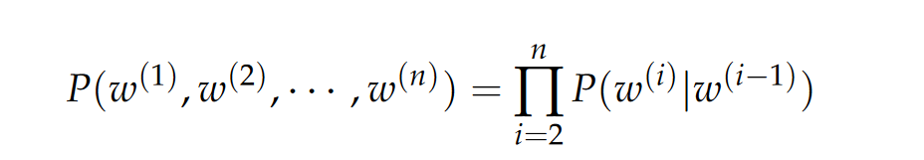
Prediction
Predict contexts instead of counting co-occurrences as with DSMs
Use language models to assign a probability to a sequence of words
Formula from https://cs224d.stanford.edu/lecture_notes/LectureNotes1.pdf

Slide 61
Dimensionality Reduction
Reduce a high-dimensional vector space with long sparse vectors of many dimensions into low-dimensional embeddings of short dense vectors of limited dimensions that are expressive for a given task

Slide 62
One-Hot Vectors
Initialize high-dimensional vector space with one-hot vectors: sparse word representations over a vocabulary V with length |V|
For example:
V | |V|
cat | 1 | 0 | 0 | 0 | 0 | 0 | 0 | 0 | 0 | 0 | 0 | 0 | 0
dog | 0 | 1 | 0 | 0 | 0 | 0 | 0 | 0 | 0 | 0 | 0 | 0 | 0
...

Slide 63
Word Embedding
f(w)
High-dimensional vector
Low-dimensional vector
Adapted from a slide by John McCrae

Slide 64
Word Embeddings
Initialize high-dimensional vector space with one-hot vectors over a vocabulary V derived from a training corpus
Count or predict (by use of a language model) co-occurrence for all words in V within a given context (e.g. bigrams) with co-occurrence taken as positive instance and as negative instance otherwise
Results in a word embedding for this corpus

Slide 65
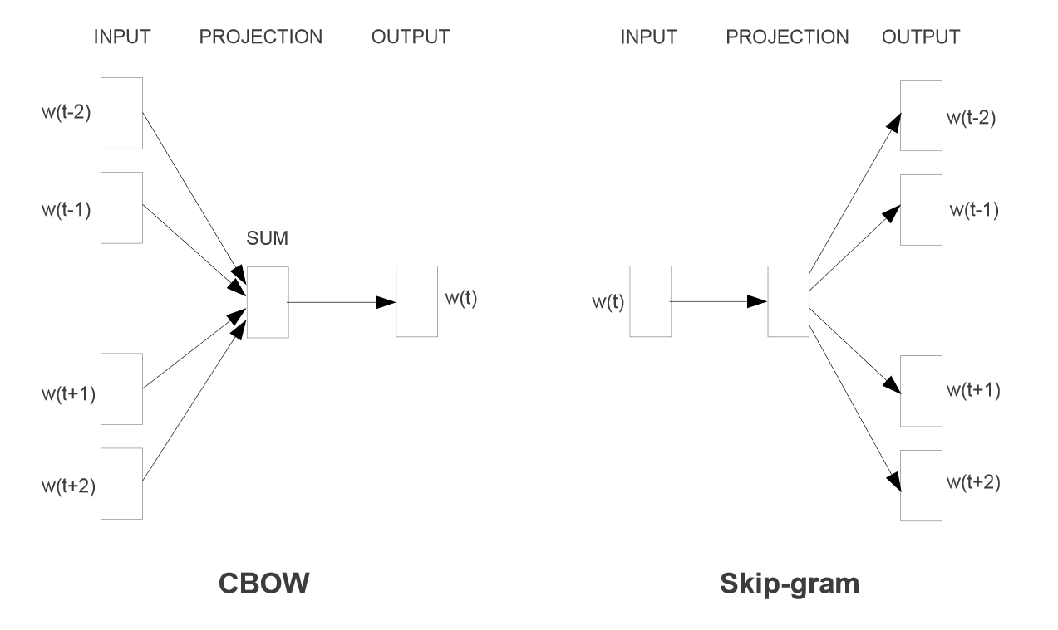
Implementation with Word2Vec
Mikolov, Tomas, et al. "Efficient estimation of word representations in vector space." arXiv preprint arXiv:1301.3781 (2013).

Slide 66
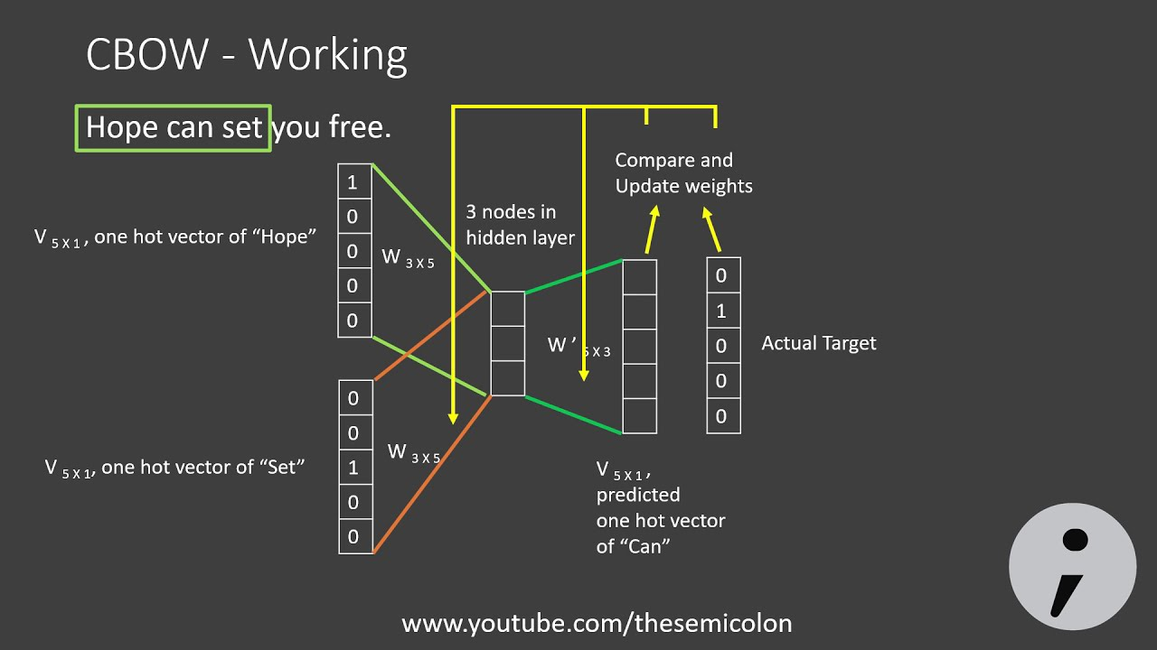
Implementation with Word2Vec - CBOW
Image from https://www.youtube.com/watch?v=UqRCEmrv1gQ

Slide 67
Pre-trained Models
A word embedding can be used as a pre-trained unsupervised model
Current best-performing NLP approaches combine pre-trained models with task-specific, supervised fine-tuning, aka as ‘transfer learning’
Originally, widely used pre-trained models were based on Word2Vec
Many other pre-trained models have now been developed

Slide 68
Some Pre-trained Models
Word2Vec (Mikolov et al 2013) - local word-word contexts with single-layer neural network
GloVe (Pennington et al 2014) - global word-word contexts with single-layer neural network
ELMo (Peters et al 2018) - bidirectional LSTM to model long-range interaction between words across a sentence
BERT (Devlin et al 2019) - bidirectional transformer to model long-range interaction between words across a sentence
Tomas Mikolov, Kai Chen, Greg Corrado, and Jeffrey Dean (2013). Efficient estimation of word representations in vector space. In Proceedings ICLR Workshop.
Pennington, J., Socher, R., & Manning, C. D. (2014). Glove: Global vectors for word representation. In Proceedings EMNLP (pp1532-1543).
Matthew Peters, Mark Neumann, Mohit Iyyer, Matt Gardner, Christopher Clark, Kenton Lee, and Luke Zettlemoyer (2018). Deep contextualized word representations. In Proceedings NAACL. (pp2227–2237).
Jacob Devlin, Ming-Wei Chang, Kenton Lee, Kristina Toutanova (2019). BERT: Pre-training of Deep Bidirectional Transformers for Language Understanding. In Proceedings NAACL-HLT (pp 4171-4186).

Slide 69
Learning Outcomes
After completing this topic, you should be able to:
Understand the foundations of distributional semantics and word embeddings
Understand how to create vector space representations for words
Understand how to use vector space representations in semantic similarity
This lecture is based in part on:
Chapter 6 in Jurafsky and Martin, SPEECH and LANGUAGE PROCESSING: An Introduction to Natural Language Processing, Computational Linguistics, and Speech Recognition, 3rd edition: https://web.stanford.edu/~jurafsky/slp3/ed3book.pdf

Slide 70




Lab of this Week
Exercises in vector space models for NLP

